Slide 1
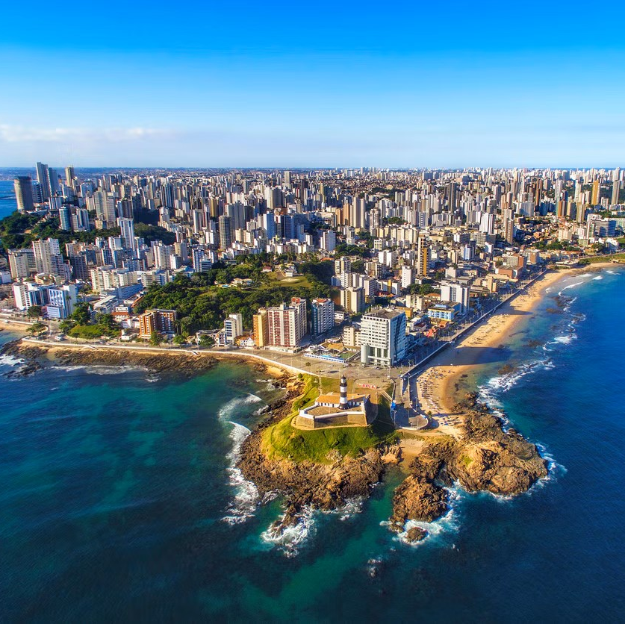
The impact of condominium fees on apartment prices in Salvador, Brazil
Exploratory Analysis of condominium fees and house prices

Slide 2
Summary of Findings
Condominium Fee and Property Prices Correlation:
As anticipated, a clear correlation exists between condominium fees and median property prices in Salvador.
Higher condo fees are consistently associated with elevated median house prices.
Condominium Fee Thresholds:
Notable trend: Properties below 1 million BRL generally have condo fees below 1,500 BRL.
Condo fees surpassing 3,000 BRL correspond to median house prices reaching 2.5 million BRL.
Nuanced Observation for High-Value Properties:
Majority of properties over 2 million BRL still below 3,000 BRL in condo fees.
Outliers exist, some exceeding 5,000 BRL, suggesting a potential cap of 10,000 BRL for luxury properties.
Impact of Condo Fee Cap Adjustment:
Previous cap of 5,000 BRL excluded high-end properties; new cap of 10,000 BRL captures values up to 9,999,999 BRL.
Improved accuracy in capturing a broader range of luxury property values.
Outliers in Properties Below 1 Million BRL:
Substantial number of outliers above the interquartile range (IQR).
Factors contributing to variance include price fluctuations, constant condo fees, and potential adjustments by advertisers.

Slide 3
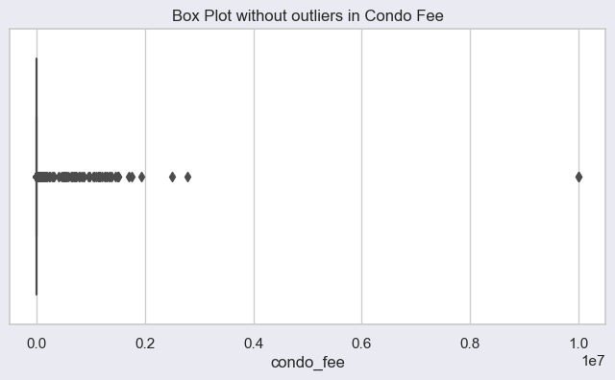
Condo Fee in its current state
Problem
Condo fee is excessive and on average the fees from 500 to 2000 real.
There could possibly be sales prices that have got mixed in the condo fee column.
Moreover, there are missing values in the condo fee, where nothing has been entered (due to property type or just that it’s non-existant.
Solution
We will write a function to keep only the values where the condominium fee is within a more reasonable range between 150 and 10000 Brazilian Real (BRL) and replacing the excessive values (filling with not applicable when it’s out of range.
The idea for the function comes from research one the Loft.com.br Portal.

Slide 4
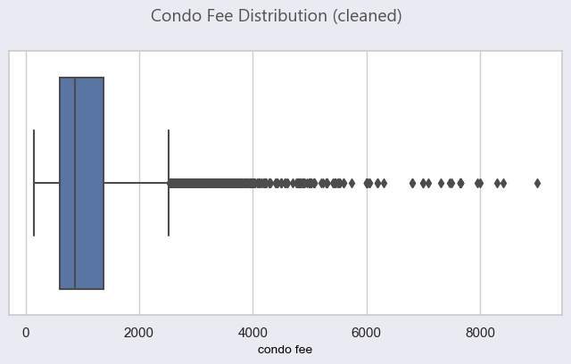
Cleaning Condo Fee Column
Explanation
The box plot displays the resulting distribution after the function was performed.
We still see similar interquartile range with a median around R$700.
In our condo fee column we have dropped the outliers below R$150 and R$10,000 Brazilian Real (BRL).

Slide 5
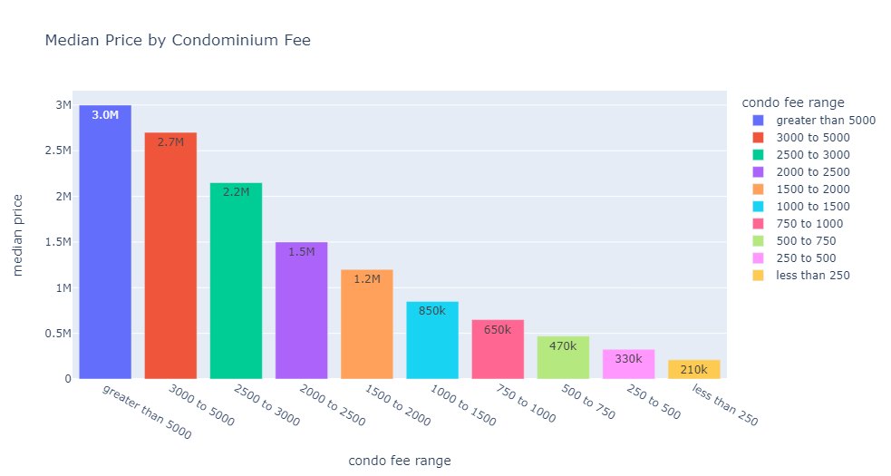
Price Analysis
High end properties
Condo fees above 5000 BRL: Median price of 3 million BRL, ranging from 315,000 to 8.2 million BRL with a count of 65.
3000 to 5000 BRL fees: Median price of 2.7 million BRL, ranging from 250,000 to 9.5 million BRL with a count of 687.
2500 to 3000 BRL fees: Median price of 2.15 million BRL, ranging from 310,000 to 7.5 million BRL with a count of 788.
Distribution
Widest fee range (less than 250 BRL to greater than 5000 BRL).
Highest median price observed in the greater than 5000 BRL fee range.
Most properties fall within the 1000 to 1500 BRL and 1500 to 2000 BRL fee ranges

Slide 6
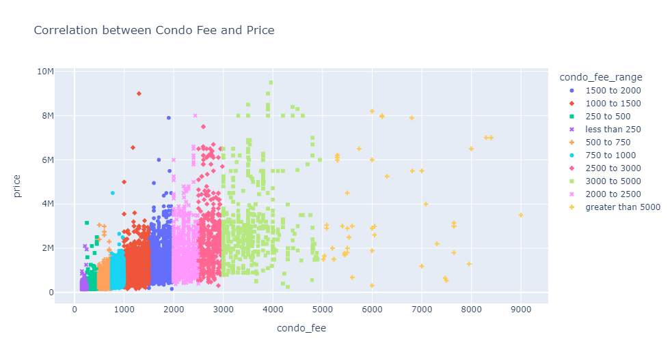
Correlation between Condominium Fee and Price
Explanation:
Positive correlation between price and condo fee as expected.
Outliers appear in the lower condo fee ranges when the price is above R$2m.
There’s less data when the condo fee is greater than R$3,000 and the correlation is more inconsistent with condo fees.

Slide 7
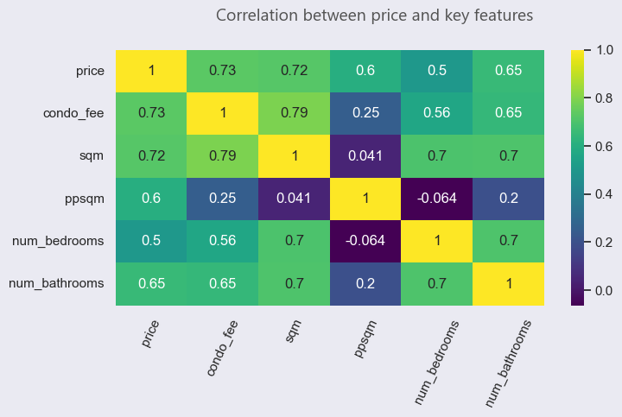
Other features
Explanation:
When looking at other features we can see that the property area (sqm) has a positive correlation to the condominium fee.
The bedrooms and bathrooms also have positive correlation.
In terms of price impact, the condo fee and property have tended to have the strongest relationships.

Slide 8
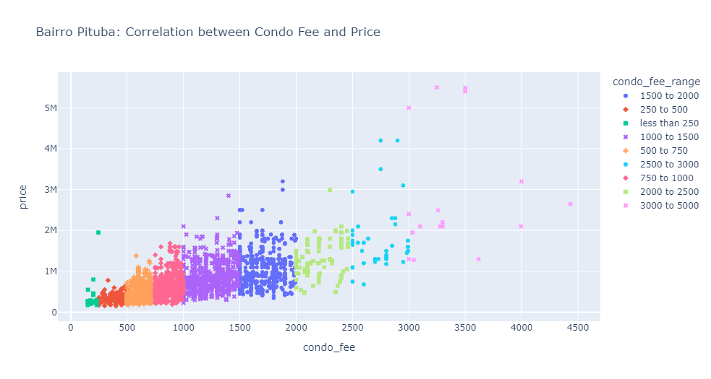
Neighborhood Analysis: Pituba
Explanation:
Positive correlation between price and condo fee as expected.
Significantly less outliers in our dataset for Pituba, which is the economic center of Salvador.
The median price is R$743,000.
The median condo fee is R$1065.

Slide 9
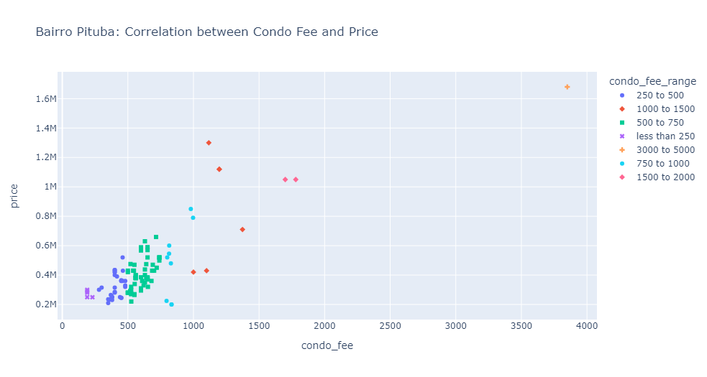
Neighborhood Analysis: Boca do Rio
Explanation:
Boca do Rio is a less popular neighbourhood for apartments and one of the least popular areas in the city.
The prices are significantly lower, mostly below R$1m.
The most significant outlier here is a single property over R$1.6m with a condo fee significantly over the median.
The median condo fee is R$625.
The median price is R$380000

